Slide 1

CSS Units

Slide 2
Units
CSS has different units for expressing different lengths
Most CSS properties take “length” values such as width, margin, padding, font-size, etc
Length is an integer, followed by its unit such as px, em, etc.

Slide 3
Types of length units
Absolute
Fixed length and will appear as exact.
Relative
Scales with different viewing devices.

Slide 4
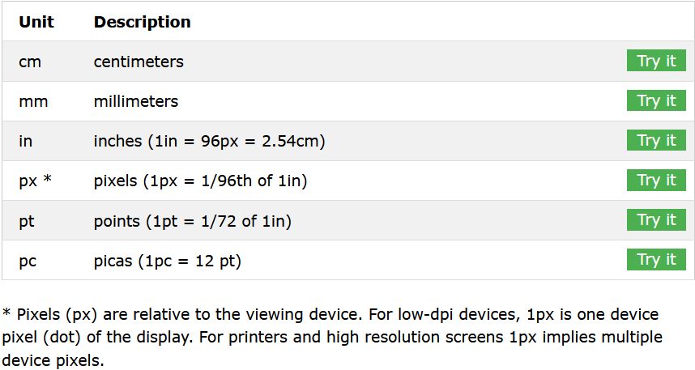
Absolute Lengths

Slide 5
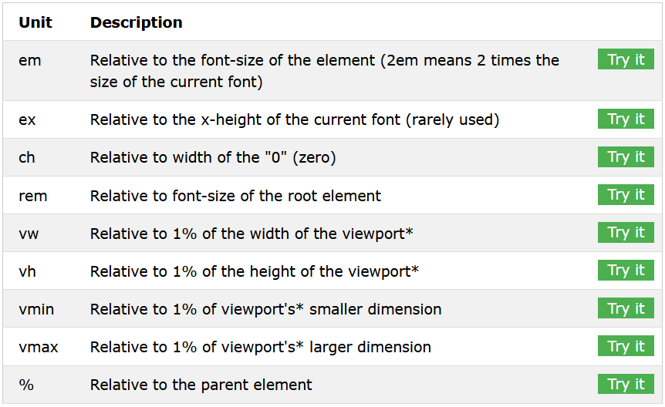
Relative Length

Slide 6
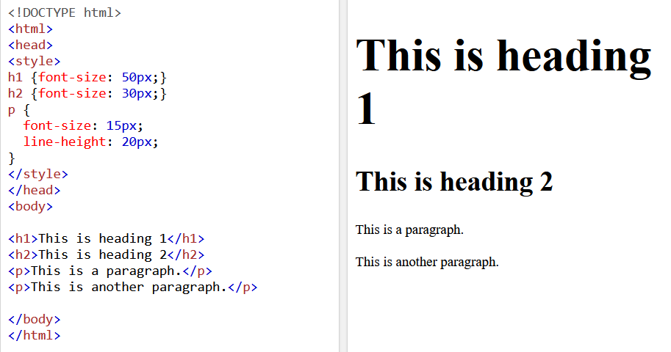
Examples: Pixels

Slide 7
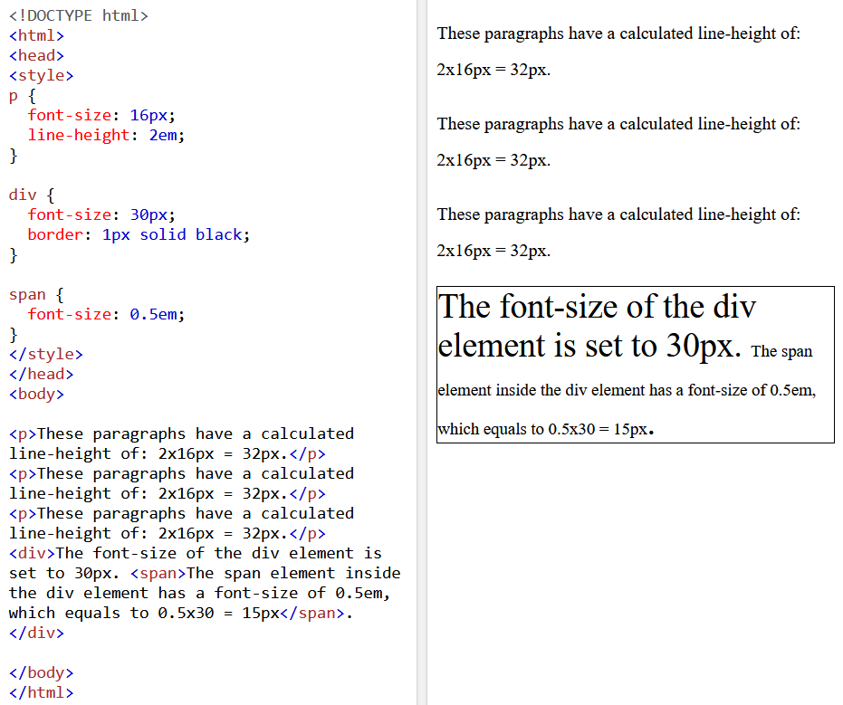
Example: em

Slide 8
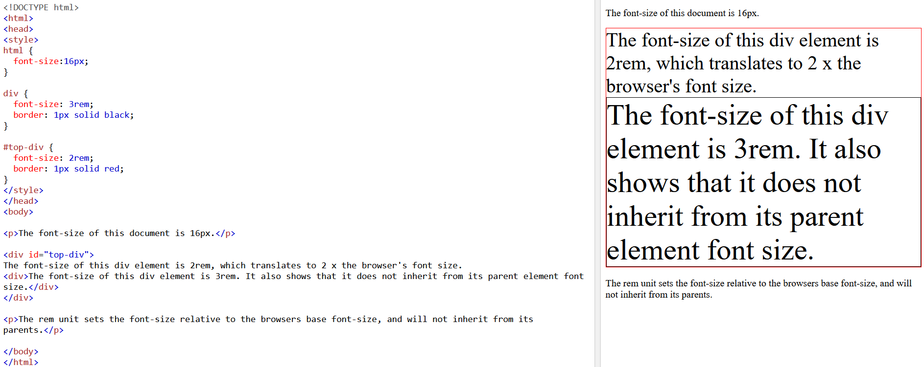
Example: rem

Slide 9
Task 6
Create a simple webpage with both HTML and CSS files.
Link the CSS file to HTML.
Do some prior editing using CSS.

